Slide 1
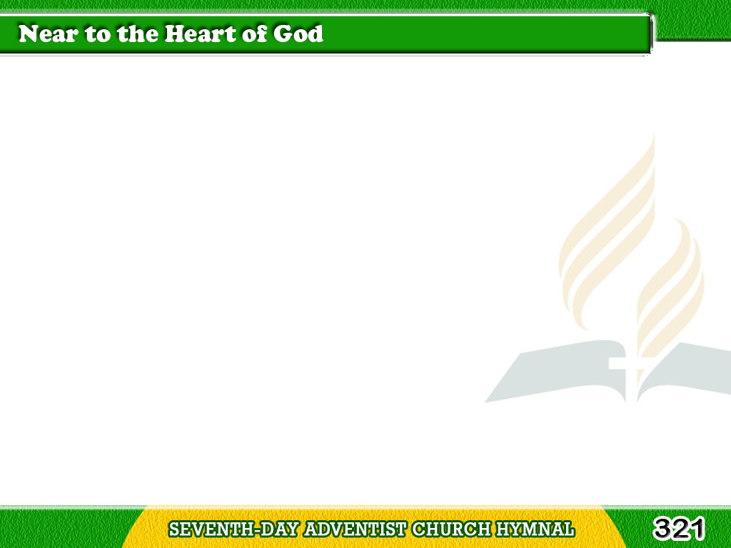
1/3
There is a place of quite rest,
Near to the heart of God,
A place where sin cannot molest,
Near to the heart of God.
Tagalog
Version

Slide 2
1/3
Chorus
O Jesus, blest Redeemer,
Sent from the heart of God,
Hold us, who wait before Thee,
Near to the heart of God.
Tagalog
Version

Slide 3
2/3
There is a place of comfort sweet,
Near to the heart of God,
A place where we
our Savior meet,
Near to the heart of God.
Tagalog
Version

Slide 4
2/3
Chorus
O Jesus, blest Redeemer,
Sent from the heart of God,
Hold us, who wait before Thee,
Near to the heart of God.
Tagalog
Version

Slide 5
3/3
There is a place of full release,
Near to the heart of God,
A place where all
is joy and peace,
Near to the heart of God.
Tagalog
Version

Slide 6
3/3
Chorus
O Jesus, blest Redeemer,
Sent from the heart of God,
Hold us, who wait before Thee,
Near to the heart of God.
Tagalog
Version

